Slide 1
Automating Reports
Flexdashboard
library(officer)
Use R Markdown to publish a group of related data visualizations as a dashboard.
Support for a wide variety of components including htmlwidgets; base-R, ggplot2
Flexible and easy to specify row and column-based layouts.
Manipulate Word (.docx) and PowerPoint (*.pptx) documents. In short, one can add images, tables and text into documents from R.
You will need Microsoft Office to make office files.

Slide 2

Awesome. No more old cars!
I work in a hospital. Its all doctors so I am sure they are data fluent.

Slide 3

Let’s make some routine reports
Dale! I am freaking out!!!
I need a report on my desk each Monday that details our diabetic patient results.

Slide 4

Use Case for Report Automation
cool.
Making routine reports is boring
Routine reports waste analytical talents’ time
We need to automate Dale’s misery!

Slide 5
Helping Dale!
1_powerpointMaker.R
2_powerpointMaker.R

Slide 6
There is another way to make powerpoints.
R library(officer)
https://davidgohel.github.io/officer/
Docx and pptx
Flexible though clunky
Uses any static image ggplot etc
Easily allows for themes
R Studio Presentation “PowerPoint”
https://support.rstudio.com/hc/en-us/articles/360004672913-Rendering-PowerPoint-Presentations-with-RStudio
Requires knowledge of markdown

Slide 7
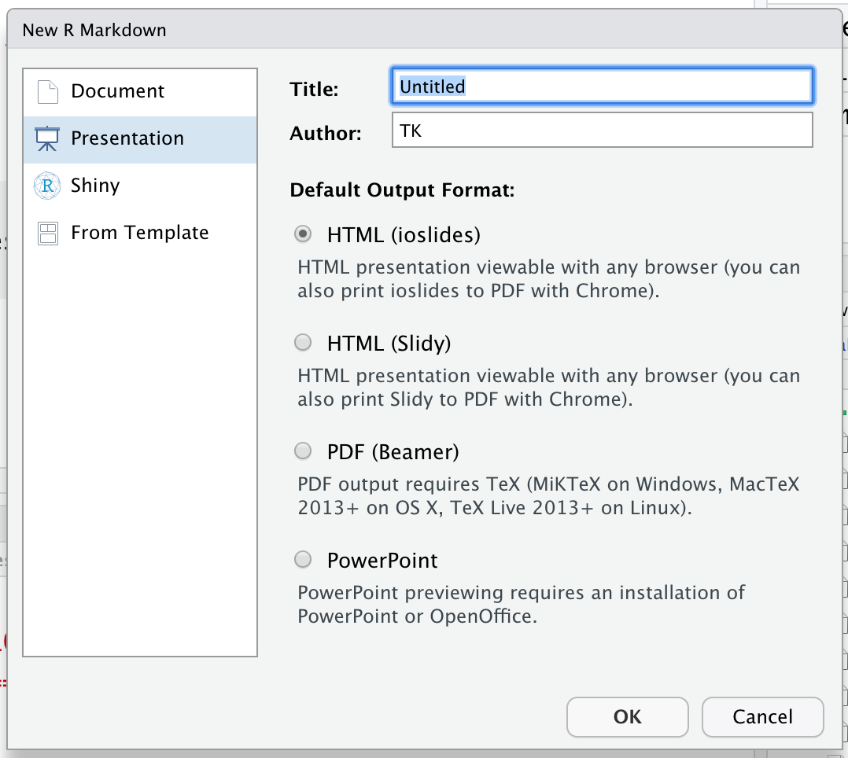
Making powerpoints
ZZ_example_pptx.Rmd
File
New File
New Markdown
Select Presentation
Select PowerPoint
https://support.rstudio.com/hc/en-us/articles/360004672913-Rendering-PowerPoint-Presentations-with-RStudio

Slide 8
Agenda
Start | End | Item
 |  | New Data Sources – APIs (JSON & XML)
 |  | New Data Sources -Web Scraping
 |  | New Data Sources – Microsoft Office
 |  | Report Automation -- library(officer)

Slide 9

Automating Reports w/FlexDashboard
But Dale, I need more interesting pictures. PowerPoint gives me a headache.
Use R Markdown to publish a group of related data visualizations as a dashboard.
Support for a wide variety of components including htmlwidgets; base, ggplot2
Flexible and easy to specify row and column-based layouts.
You’ve been building dashboards all semester with markdown.

Slide 10
fine.
Let’s add some dynamic reporting!

Slide 11
Let’s practice!
C_flexdashdashboard.rmd

Slide 12

Stable Diffusion’s version of excited business people
So Pretty!
I don’t even work here!
I knew you could do it Dale!
Go diabetes patients!

Slide 13
Ungraded Challenge (not Homework)!
Build a PowerPoint using week 3 data, change all of the graphs variables and save the PowerPoint. Add another slide.
Build a flexdashboard using week 4 data, again change the charts and tables info. Turn in the html.

